Slide 1
Lesson 10 – Further Preaching In Galilee Jesus’ Commission to His Disciples – Matthew 9:35-11:1 Death Of John the Baptist – Matthew 14:1-12; Mark 6:14-29; Luke 9:7-9 The Feeding Of The 5000 – Matthew 14:13-21; Mark 6:33-44; Luke 9:11-17; John 6:2-14 January 1, 2020

Slide 2
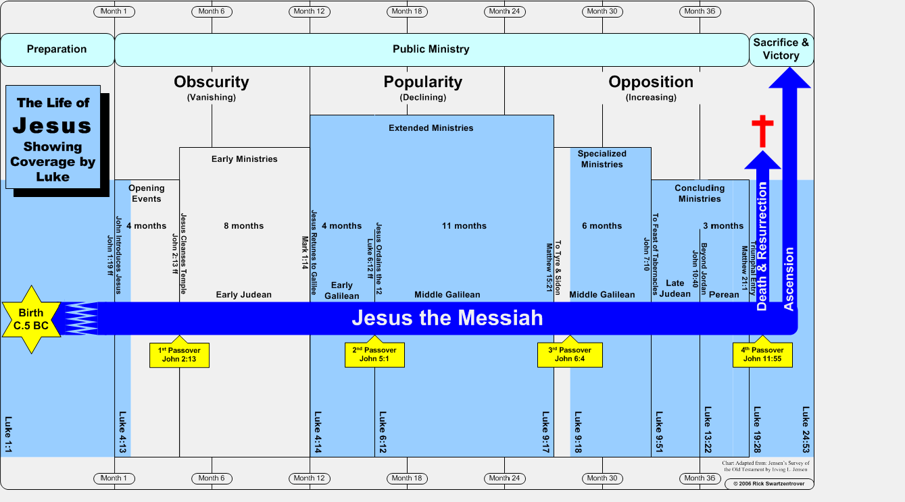
Project analysis slide 2
Timeline of Jesus’ Life
W
Notes:
Mark 4:40; “Do you still have no faith?” Lit. “not yet” (Strong) “Do you not yet?” (Thayer) From the Greek “pistis” meaning “persuasion, i.e. credence, moral conviction.” (Strong)

Slide 3
Project analysis slide 2
3rd Tour of Galilee - 12 Sent Forth
Matthew 9:35-11:1; Mark 6:6-13; Luke 9:1-6
Jesus saw people who were: “Distressed … dispirited” and “like sheep without a shepherd” (Ezekiel 34:1-16, 23-24)
Jesus “felt compassion for them.”
Jesus then said to His disciples, “The harvest is plentiful, but the workers are few.” (John 4:34-38)
Jesus called for more workers. “Beseech the Lord of harvest to send out workers into His harvest.”
Jesus gave the 12 “authority over unclean spirits …” and the power to “heal every kind of disease and every kind of sickness.”
Jesus sent them, not to the Gentiles or the Samaritans but only “to the lost sheep of the house of Israel.” (Matthew 15:25; “lost”, Matthew 18:11; 16:26)
Notes:
“Dispirited” - Matthew 15:30

Slide 4
Project analysis slide 2
3rd Tour of Galilee - 12 Sent Forth
Matthew 9:35-11:1; Mark 6:6-13; Luke 9:1-6
Jesus’ commission:
“Preach saying, ‘the kingdom of heaven is at hand.’” (10:7)
Confirm the message with miracles. (10:8)
Trust God for your provisions and your message (10:9-10; 19-20)
Preach wherever the gospel is received, move on when it isn’t. (10:11-15, 23)
Notes:
Apostle means more than just “send” but send as a representative under commission from the sender.

Slide 5
Project analysis slide 2
3rd Tour of Galilee - 12 Sent Forth
Matthew 9:35-11:1; Mark 6:6-13; Luke 9:1-6
Jesus’ commission:
Warnings: they will be “sheep in the midst of wolves.” (10:16; Matthew 7:15-20; Acts 20:29)
The need to “be shrewd as serpents and innocent as doves” (10:16):
“Shrewd” - wise and prudent; discreet. My word: strategic. (Matthew 7:24; 25:1-13; cf. Ephesians 6:10-13)
“Innocent” - pure, free from deceit or guile. (Philippians 2:15; Luke 21:8)
“I want you to be wise in what is good and innocent in what is evil.” (Romans 16:19)
Notes:
Threat of wolves - some suggest Jesus just speaking about physical danger but the spiritual danger is Jesus true focus. See vs. 28

Slide 6
Project analysis slide 2
3rd Tour of Galilee - 12 Sent Forth
Matthew 9:35-11:1; Mark 6:6-13; Luke 9:1-6
Jesus’ commission:
Warnings: they will be “sheep in the midst of wolves.” (10:16; Matthew 7:15-20; Acts 20:29)
“They will hand you over to the courts” (10:17)
They will “scourge you in their synagogues” (10:17)
“You will even be brought before governors and kings for My sake” (10:18)
Families will be divided to the extent that “children will rise up against parents and cause them to be put to death”. (10:21-22; 35-39)

Slide 7
Project analysis slide 2
3rd Tour of Galilee - 12 Sent Forth
Matthew 9:35-11:1; Mark 6:6-13; Luke 9:1-6
Jesus’ commission:
As disciples, submit and become like your Teacher. (10:24-25)
Be courageous, bold and trusting. (10:26-31)
Don’t fear – focus on the spiritual. (Psalms 56)
Speak boldly. (Ephesians 6:18-20)
Trust in your value to God.
Take your stand. Confess Jesus. (10:32-33; Romans 10:9-10; Mark 8:38)
Focus on the “reward.” (10:40-42; Psalms 19:11; 58:11; Isaiah 49:4; Matthew 5:12; Colossians 3:24; Hebrews 10:35; 11:6; Revelation 22:12)

